Slide 1
JOURNEY PPT Technical Onboarding - Week 2
Afrin Siddiqui – IDA
Supervisory Organization: PTIY/FBD CC HR and Corporate (Pankaj Janak Kumar) (59726509)
Position Title: 54077724 Associate Data Engineer
Location: Bangalore RMZ-ECO WORLD
Employee ID: 654991

Slide 2
Day 1 – Shell Foundations Case Study
Worked on the problem statement for the Spring Boot Application using Azure
Performed various activities such as Project Management Setup, Github Repository and Feature branchin, Azure VM Configuration etc
Also worked on implementing the CI/CD workflow for the PS.
Submitted the case study documents within the time frame.

Slide 3
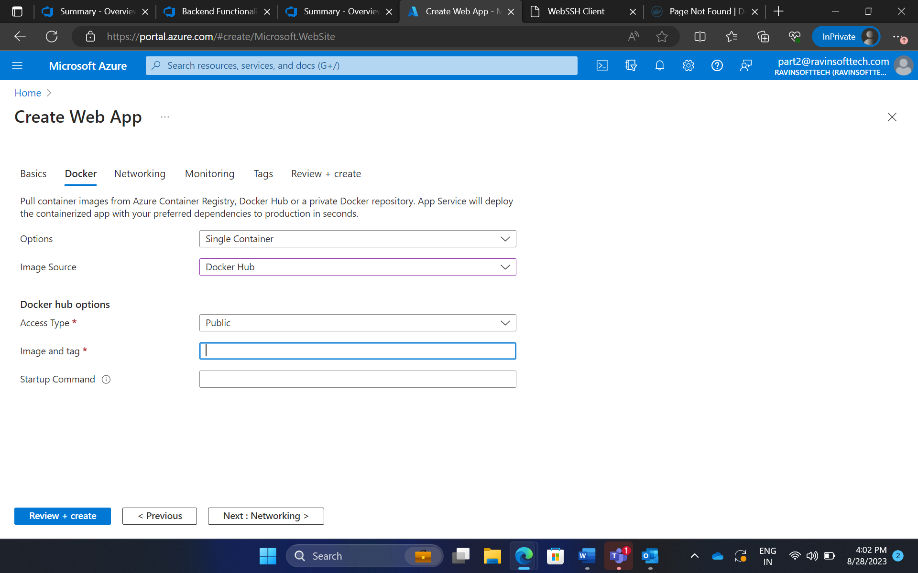
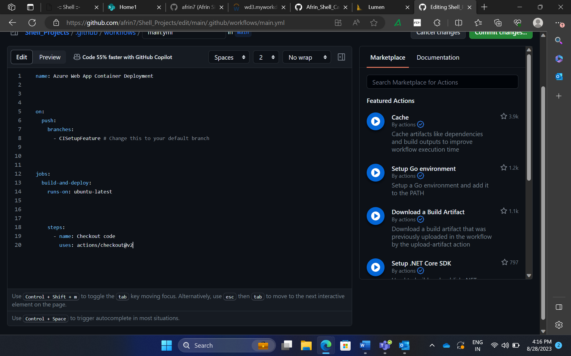
Day 1 – Hands on training/ Practical Work

Slide 4
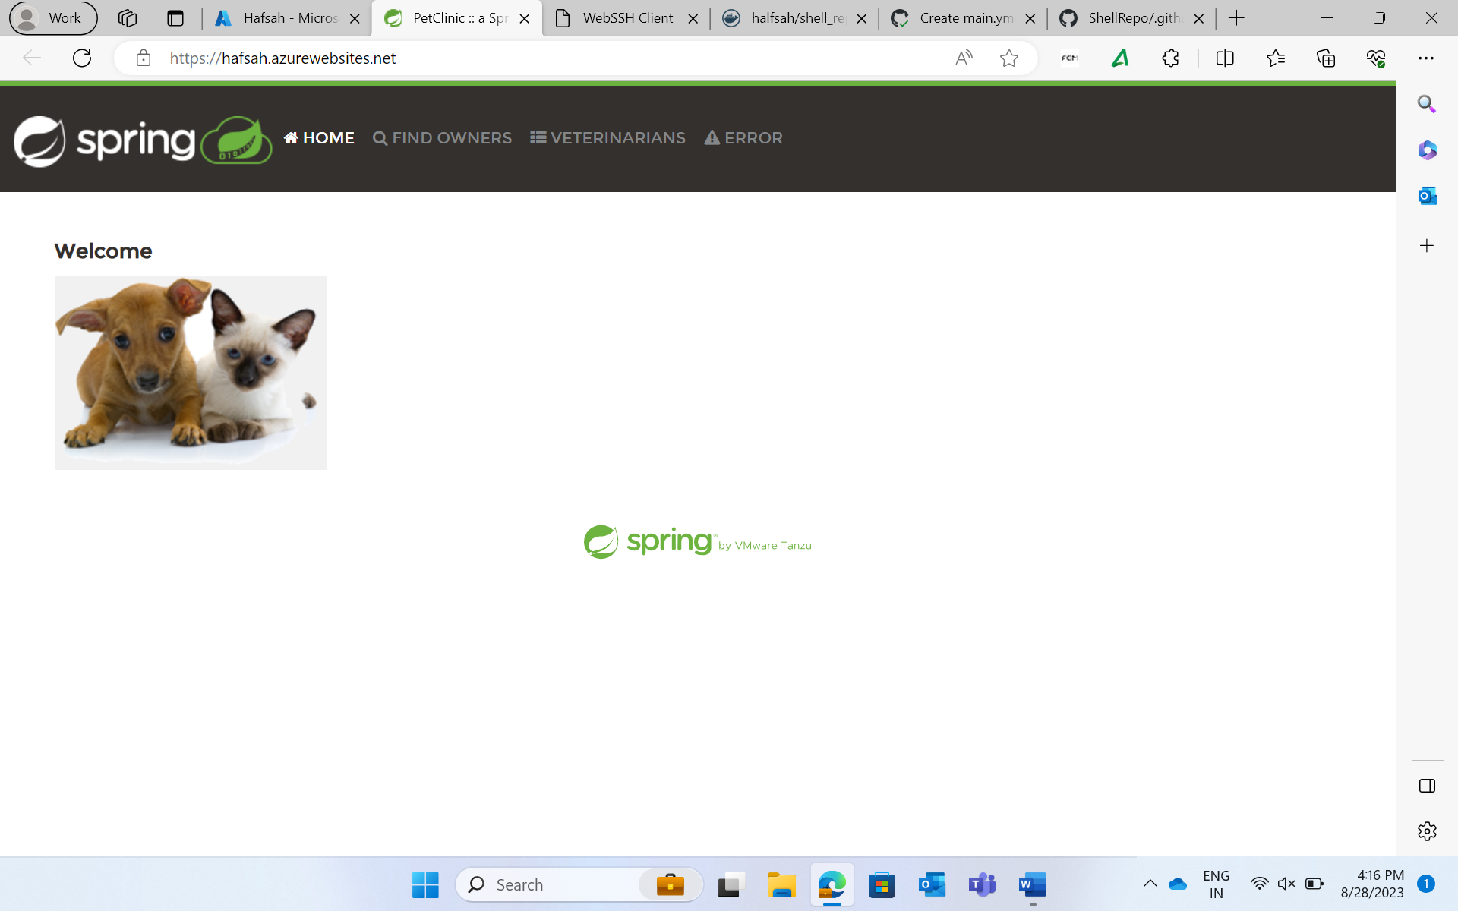
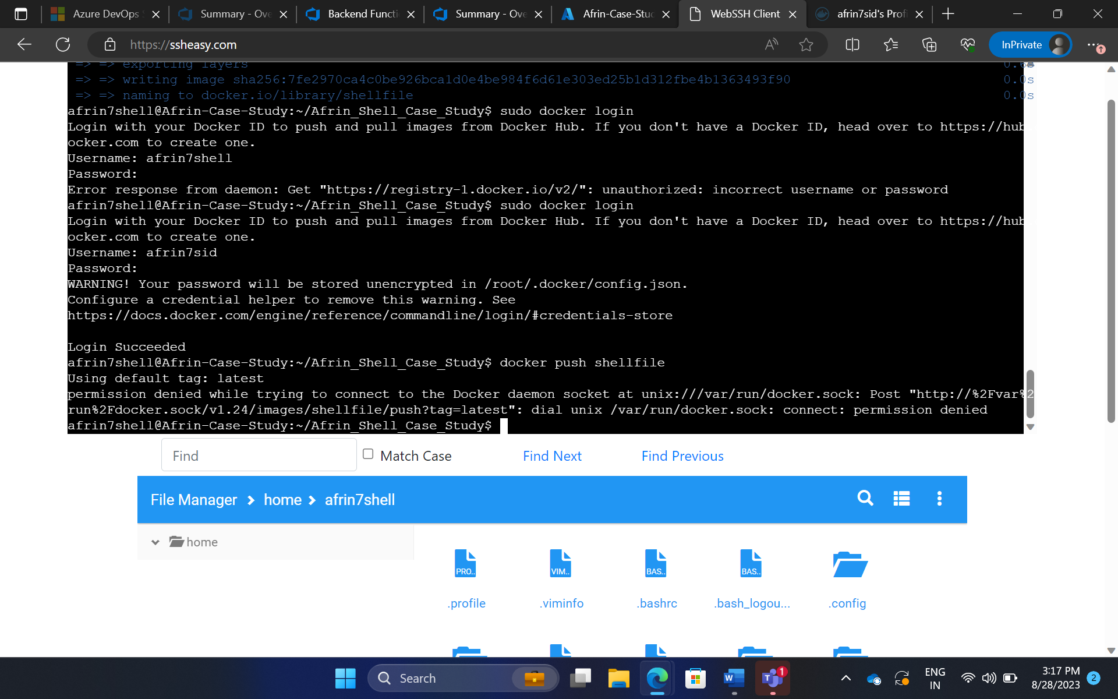
Day 1 – Hands on training/ Practical Work

Slide 5
Day 2 – SQL and NoSQL Concepts
Learned about creating ER diagrams for SQL databases.
Different schema configurations such as star, multi-star and snowflake schemas were elaborated.
Dived into unstructured data concepts such as Key volume, Document DB, Wide Column DB and Graph based DB.
Created account in Neo4j and worked on LiveSQL.

Slide 6
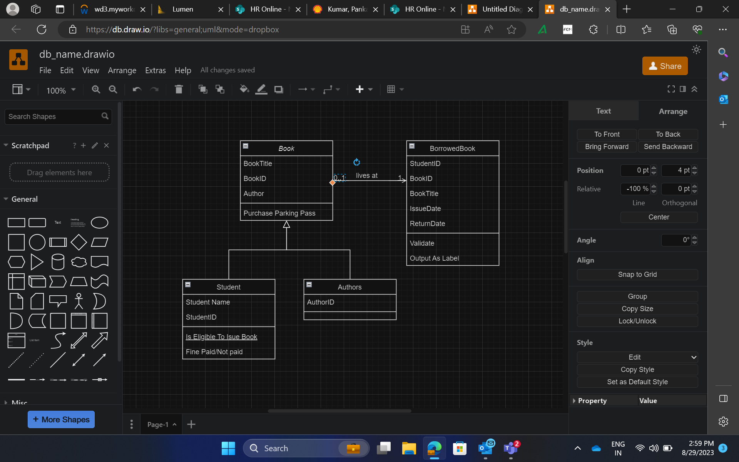
Day 2 – Hands on training/ Practical Work

Slide 7
Day 3 – SQL Databases
Did practical training which consisted of creating SQL database and writing appropriate SQL queries.
Imported database onto Microsoft.azure.portal and manipulated using SQL queries.

Slide 8
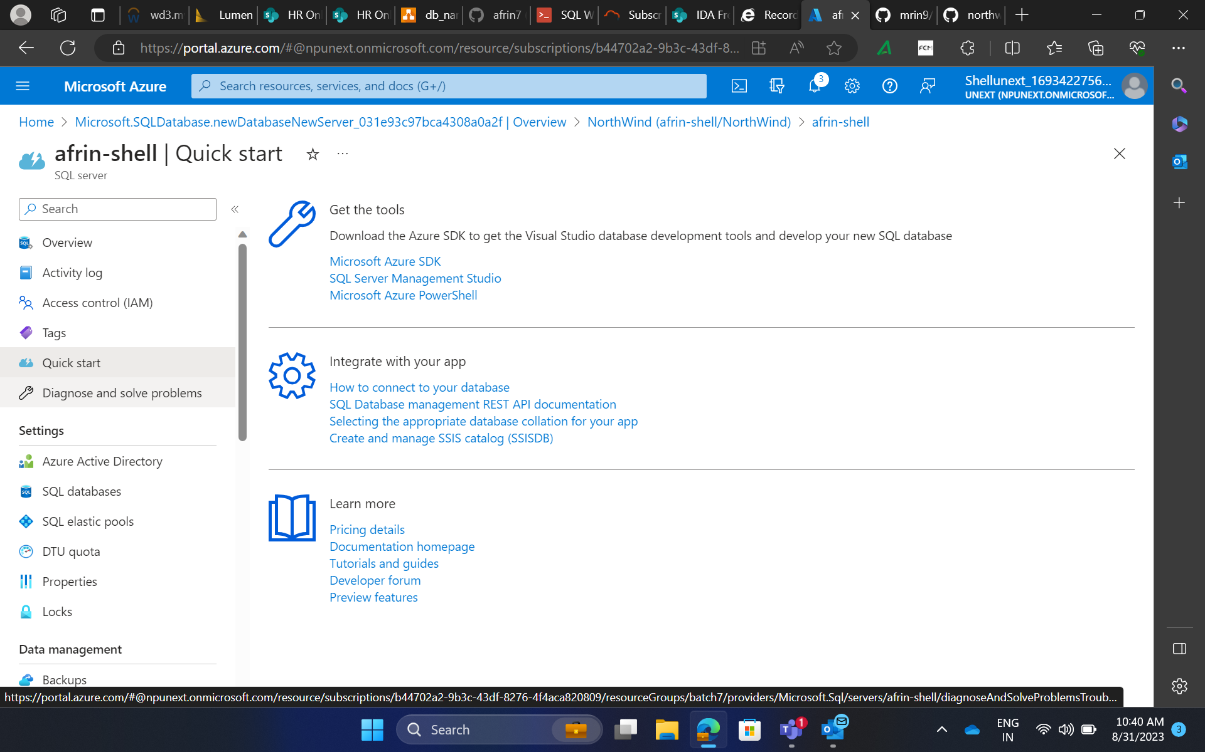
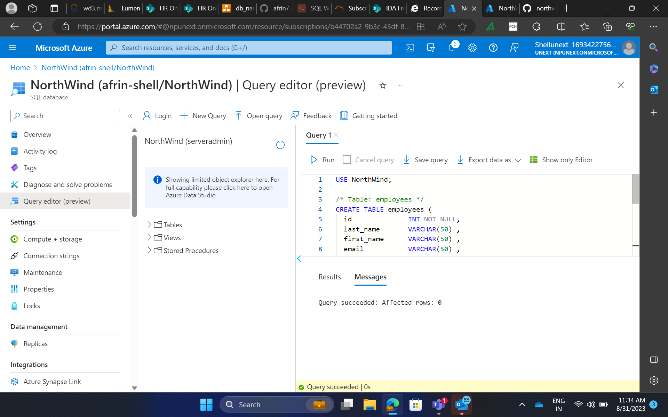
Day 3 – Hands on training/ Practical Work

Slide 9
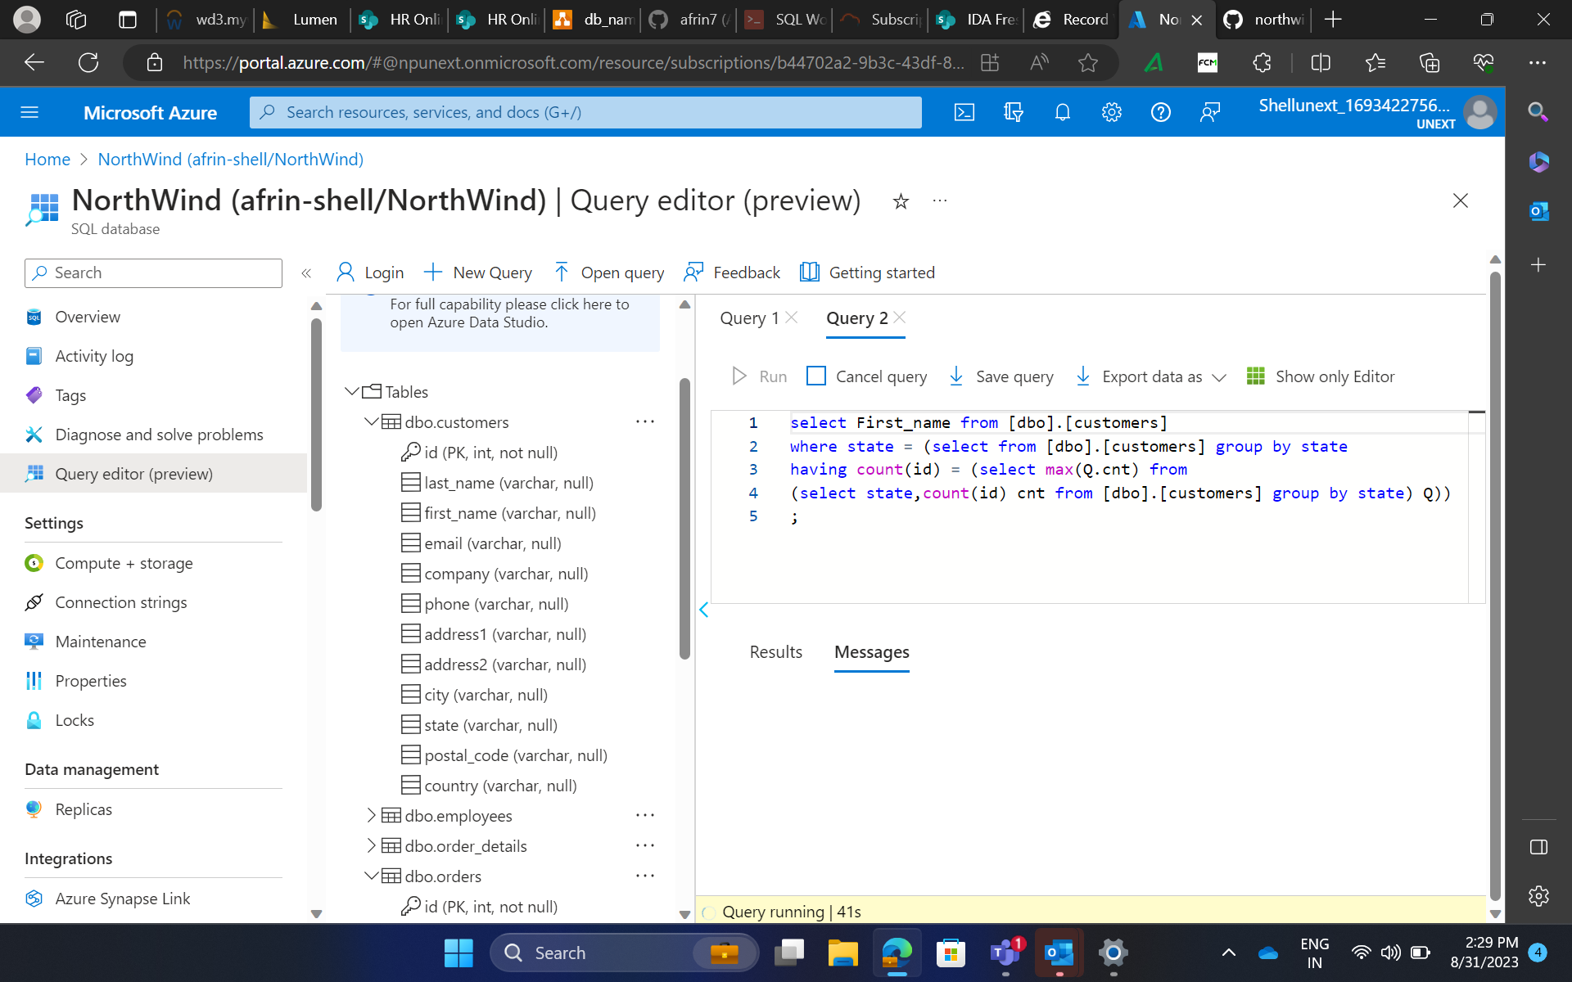
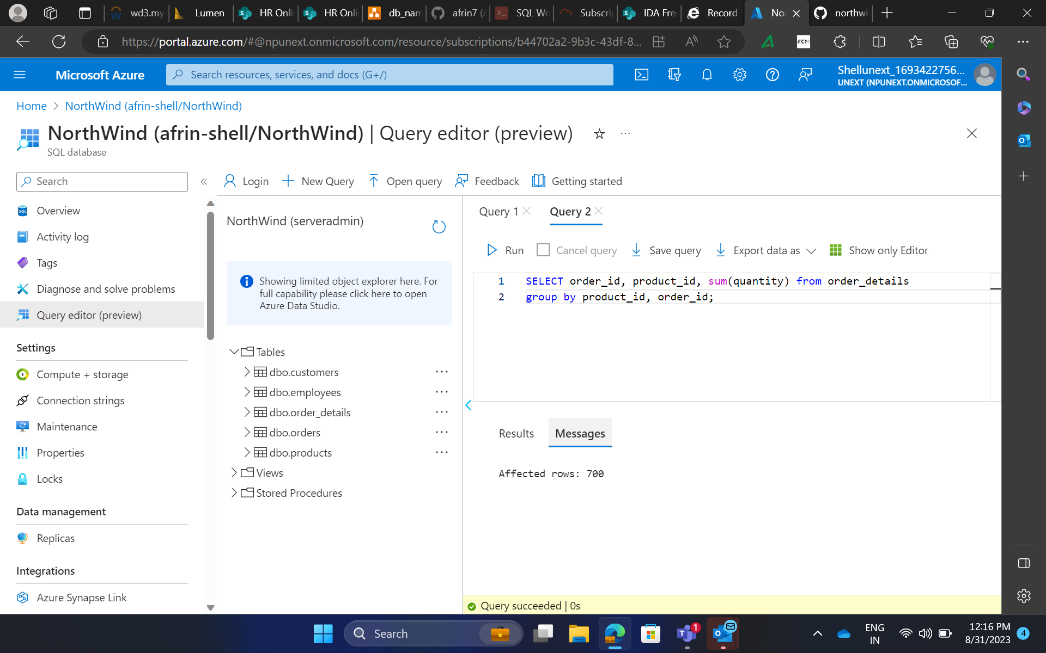
Day 4 – SQL Hands on Training
Did practical training which consisted of creating SQL database and writing appropriate SQL queries.

Slide 10
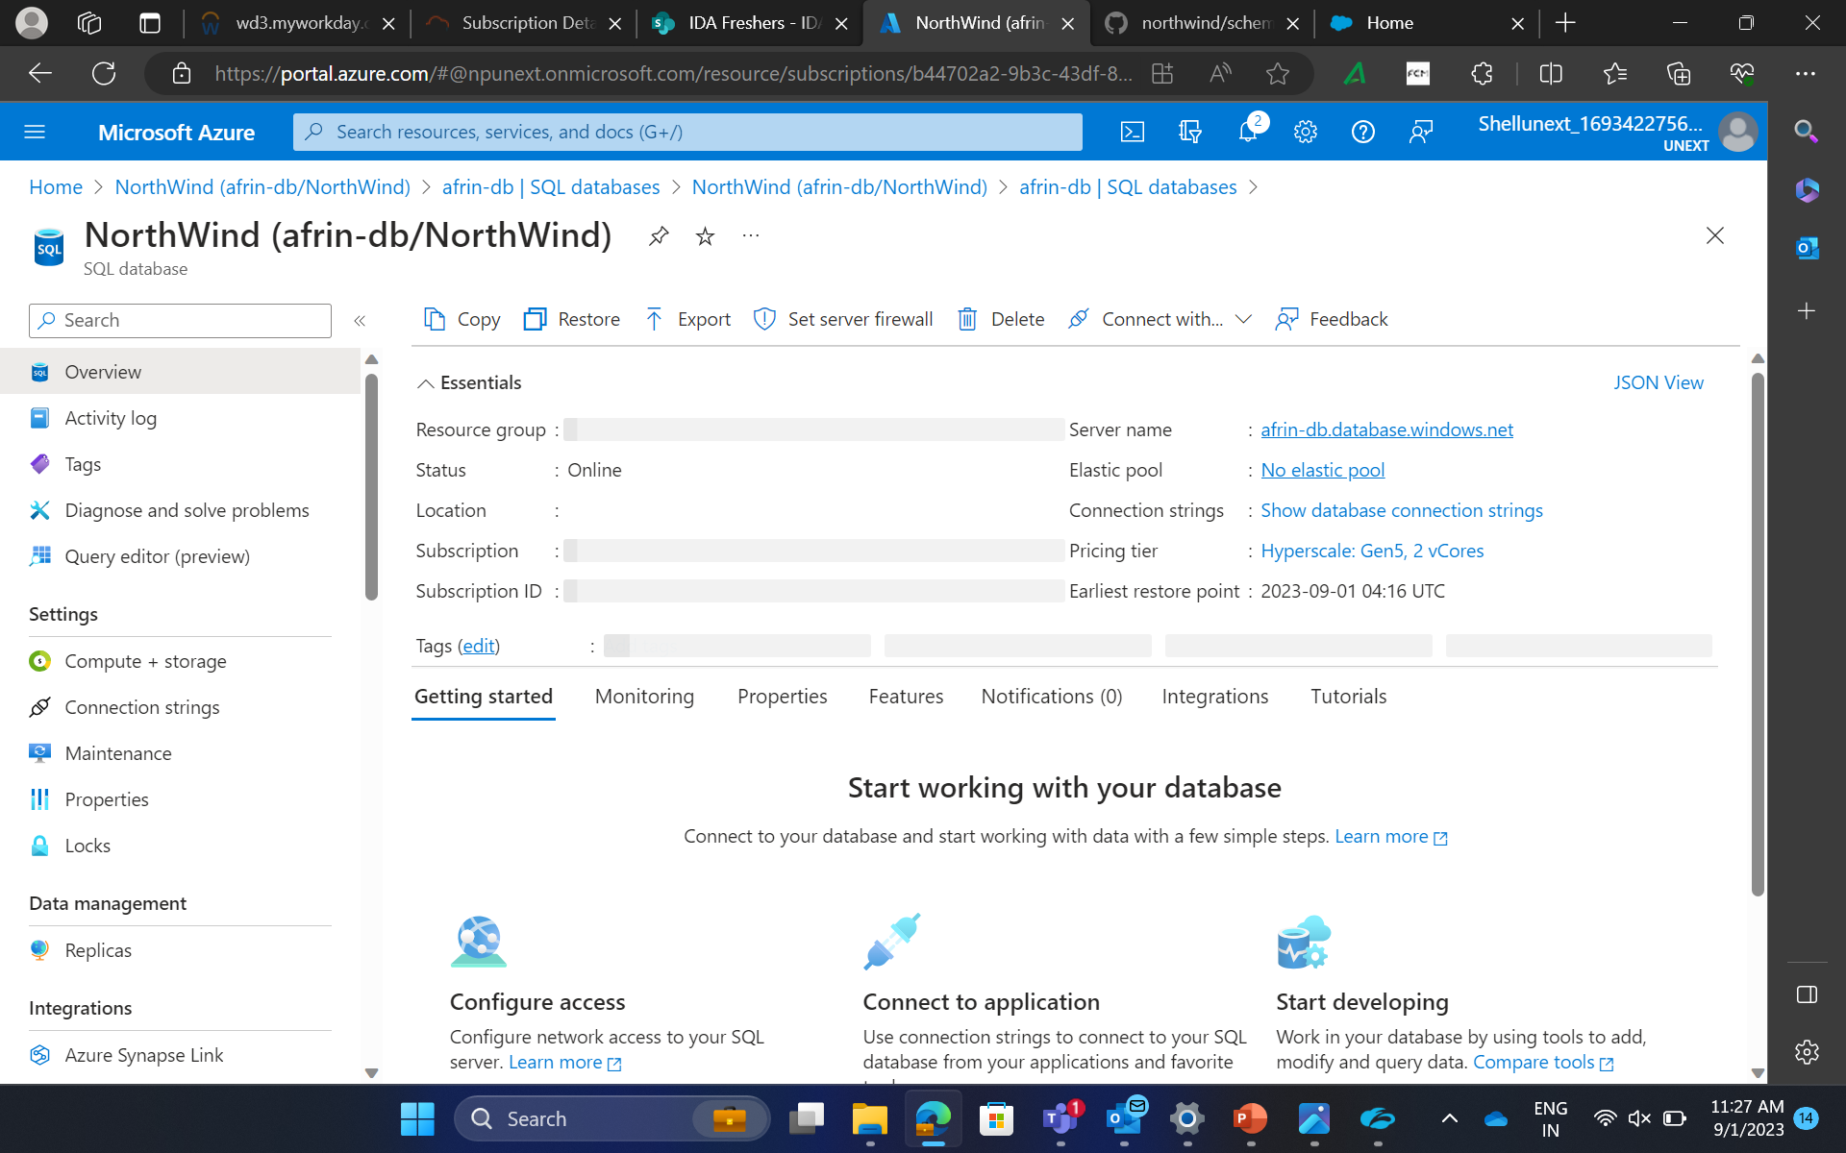
Day 5 – Weekly Assessment and SQL Hands on Training
Completed the weekly assessment on Azure Fundamentals and Data mining.
Continued to perform SQL queries on data schema and manipulated the data.

Slide 11


